Slide 1



Wheelchair Securement Systems and Occupant Protection Issues for Wheelchair Seated Passengers
Nichole Ritchie Orton - July 19, 2019

Slide 2
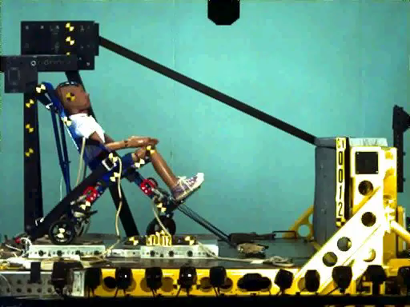
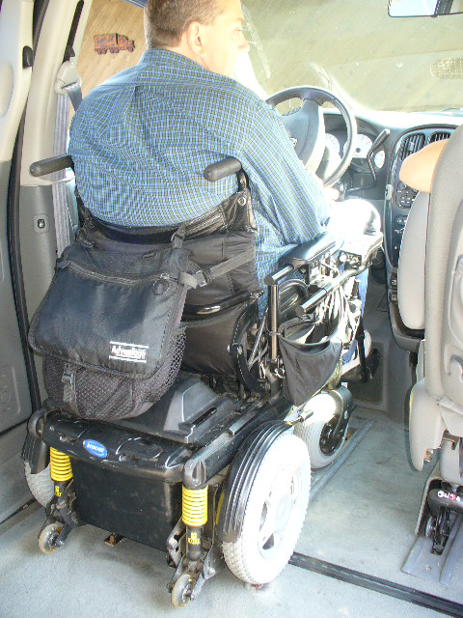
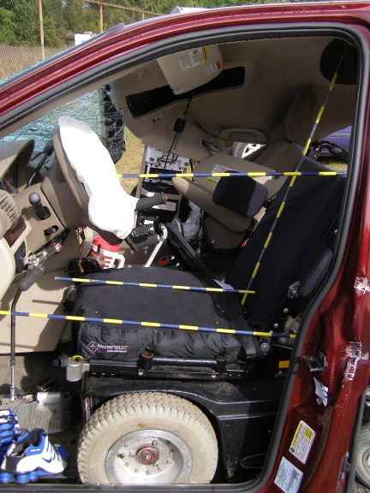
UMTRI – Wheelchair Transportation Safety
WTS research, since mid 1980s
RERC – 12 years
Crash testing and
stds development
(ISO and RESNA)
Crash investigation
Physical ergonomics
Work in private, public and school transportation
Defining best practice

Slide 3

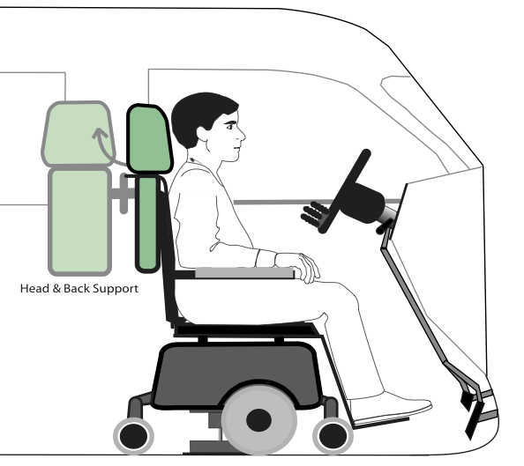
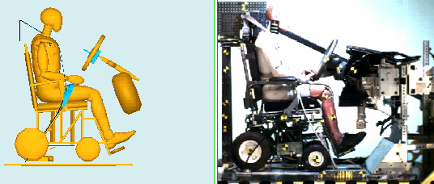
UMTRI – Wheelchair Transportation Safety
Technology development
Computer modeling
MCity = AV and DV test bed
Connected Vehicles/Infrastructure

Slide 4
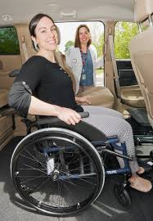
WTS Goal:
Similar Level of Safety
Ideally, people seated in wheelchairs would have similar injury risk as people in conventional seating.
Big design differences between vehicle seats and wheelchairs.
Wheelchair features influence safety.
Some transfer to vehicle seats and stow wheelchairs.
Clash of medical device and auto safety approaches to safety.
No data on differences in physical tolerance.

Slide 5
WTS Standards
NHTSA has stated that WTORS fall outside of their scope, so have not addressed WTORS in a dedicated federal motor vehicle safety standards (FMVSS). They do refer to voluntary industry standards developed by RESNA and SAE.
The transportation aspects of the US ADA focus primary on accessibility of transportation, from a civil rights perspective. Applies to public transportation. Safety is addressed secondarily.

Slide 6
WTS Standards
RESNA and ISO have developed voluntary standards that can be used to evaluate products.
Scope | RESNA Standard | ISO Standard
WTORS | WC18 (was SAE J2249) | 10542-1
Wheelchairs used as Seats in Motor Vehicles | WC19 | 7176-19
Wheelchair Seating | WC20 | 16840-4
Rear-facing Spaces in Large Buses | WC10 | 10865-1
Forward-facing Spaces in Large Buses | --- | 10865-2

Slide 7
WTORS Standards – WC18 and 10542-1
  Key requirements, a WTORS must:
  secure WC separately from occupant (not through)
  provide both upper- and lower-torso belt restraints designed to apply restraint forces to skeletal regions of the pelvis and shoulder(s)
  be dynamically strength tested in 30-mph frontal impact using a 187-lb SWC and 170-lb crash dummy (restrained with a WC-anchored lap belt for WC18).
  Largely performance based.
  Includes labeling and instructions requirements.

Slide 8
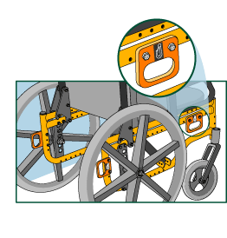
WC Standards:
WC19 and 7176-19
  Key requirements, a WC must:
  Have easy to find securement points
  Work well with seatbelts
  Be crash tested for high g conditions
  Have necessary
  qualities of a vehicle seat
  Largely performance based.
  Addresses ease of use issues.
  Includes labeling and instructions requirements.

Slide 9
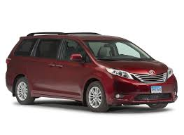
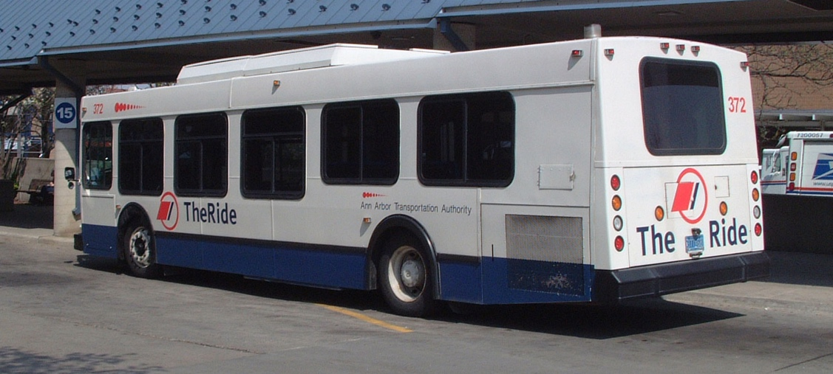
Different Vehicle Environments
Heavy vehicles are safer than light vehicles.
Light vehicles (GVWR 8500 lb or less) - Passenger cars, minivans, light trucks, SUVs more likely to experience high g crashes.
Passengers are protected by seat belts, airbags, etc. (30 mph/20 g)
Heavy vehicles (GVWR > 10,000 lb) –
City buses are much less likely to experience high g crashes,
Passengers allow to ride while standing. (1-3 g)

Slide 10
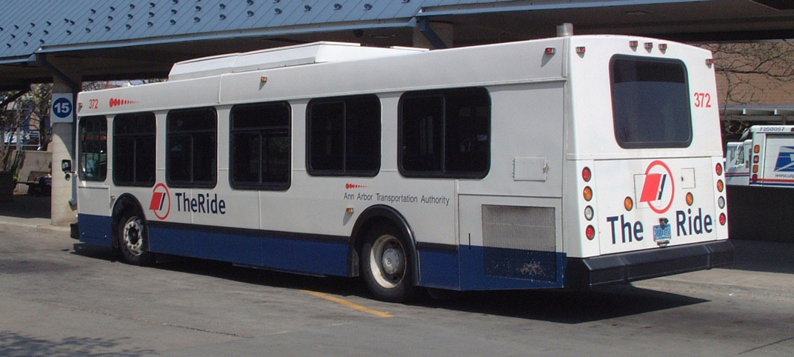
Different Vehicle Environments have Different WC Safety Solutions
4-point Tiedowns
High-g Docking Systems
Occupant Restraint (20 g, 30 mph delta V)
Rear-facing Stations
4-point Tiedowns
3-point Tiedowns
Low-g Docking Systems
Occupant Containment
(1-3 g)
Collectively all these products are called “WTORS”
Wheelchair Tiedown and Occupant Restraint Systems

Slide 11
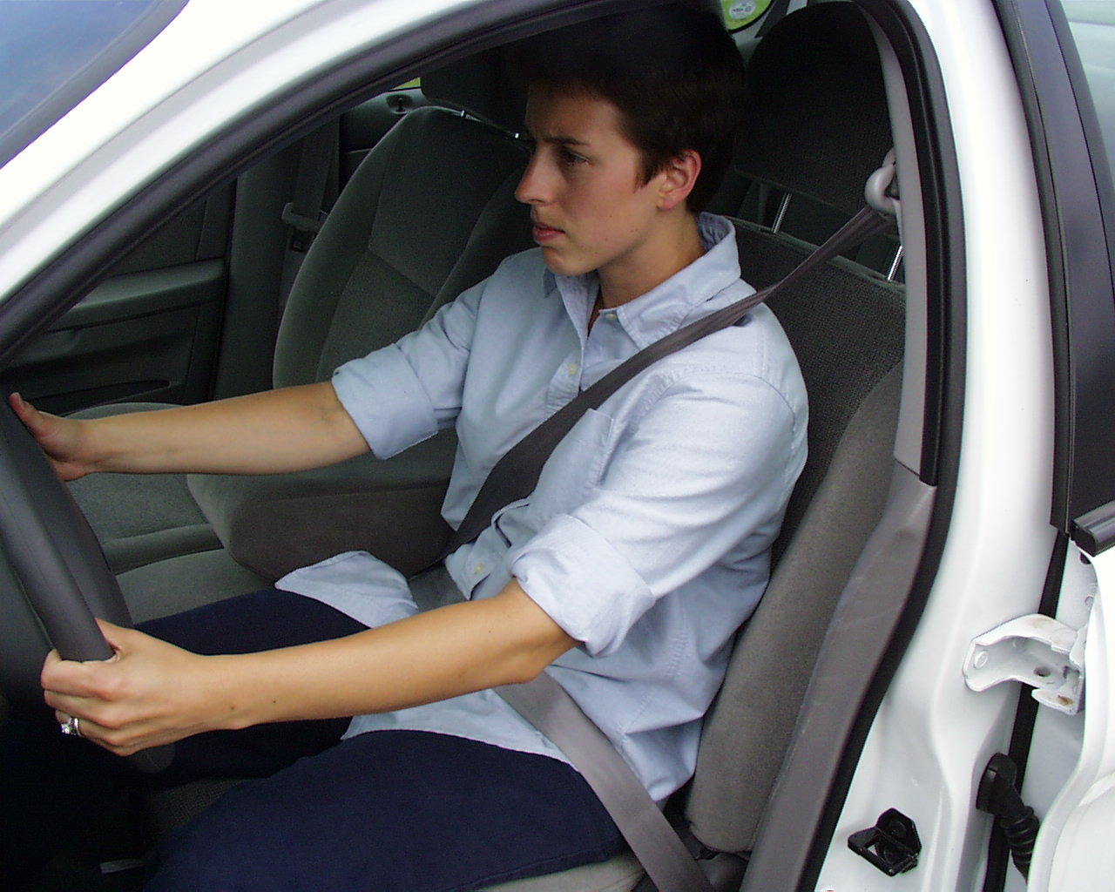
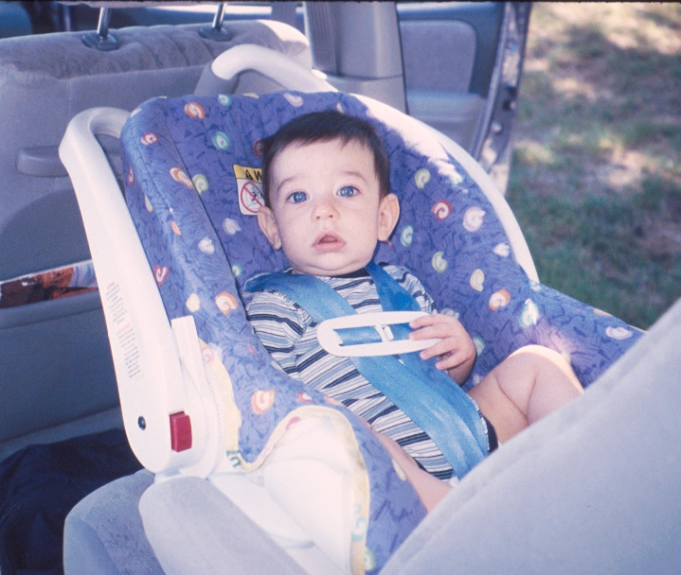
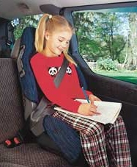
High g Environment Basic Principles
Most disabling and fatal injuries in MVCs occupants happen because of occupant impact with the vehicle interior or with objects outside the vehicle (e.g., the ground, other vehicle). In particular, head contact is primary concern.
A secondary cause of injury is improperly positioned belt restraints.
The single most effective way to reduce the risk of serious injuries to occupants involved in motor-vehicle crashes is through the use properly positioned belt-type occupant restraint systems that prevent or minimize human collisions.

Slide 12
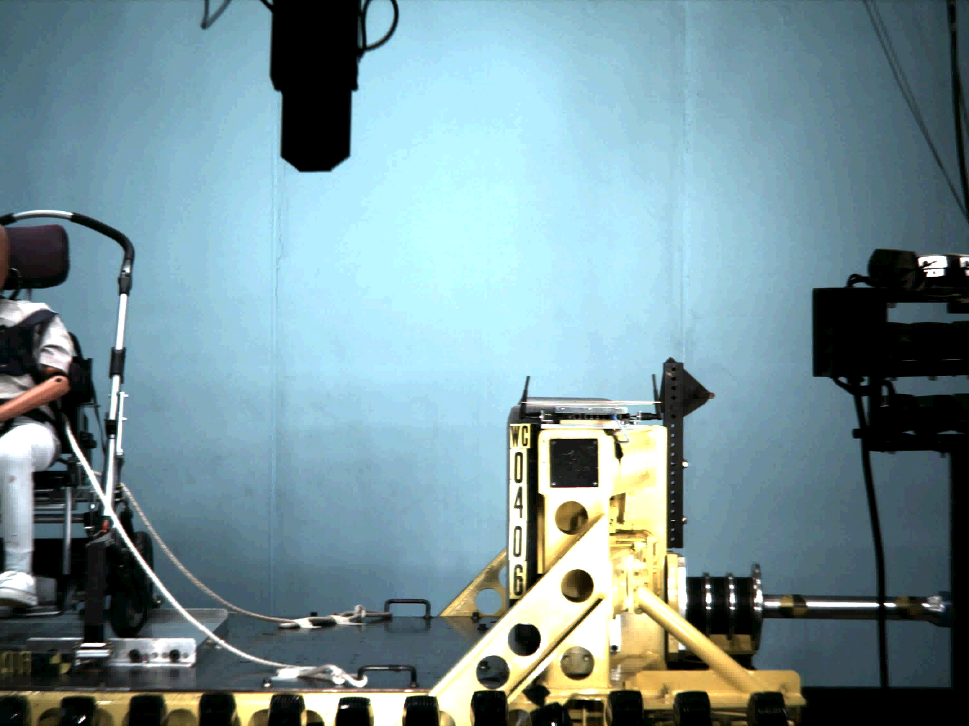
In Passenger Vehicles – Travel Forward Facing

Slide 13
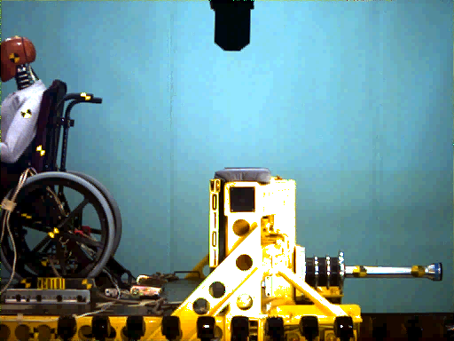
In Passenger Vehicles – Travel Forward Facing

Slide 14
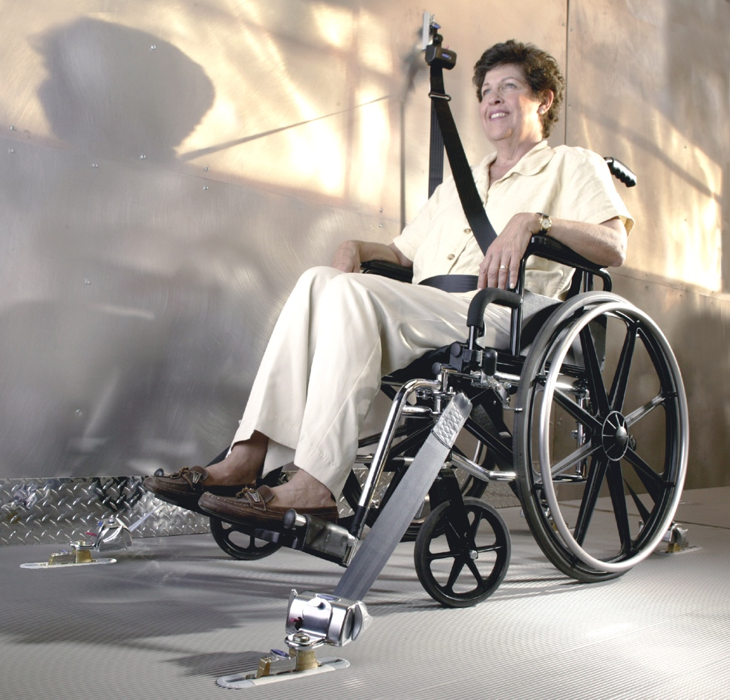
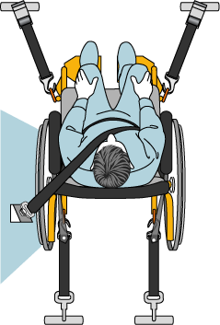
Passenger Vehicles: 4-point Strap Type WTORS
Currently most common and effective WTORS system is 4-pt, strap-type tiedown with vehicle-anchored lap+shoulder belt.
Four adjustable straps connect WC frame with vehicle floor
Works with a wide range of wheelchairs.
Crashworthy in all vehicles.
Cannot be independently used.
Sometimes paired with a vehicle-mounted back + head support.
Difficult to get good seat belt fit.

Slide 15
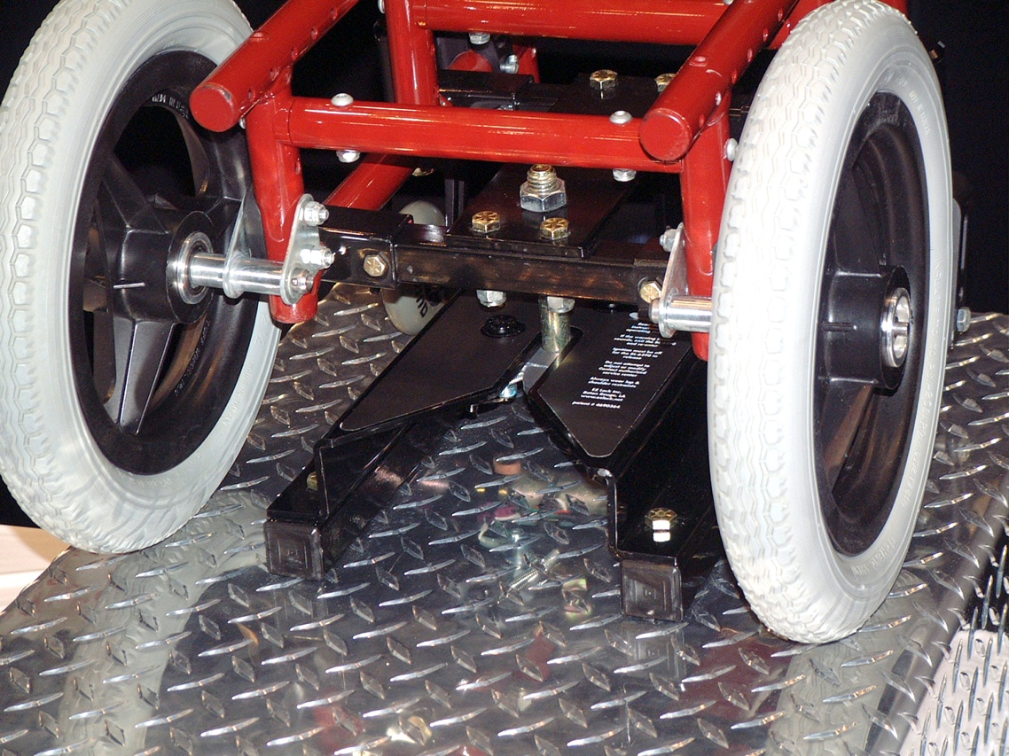
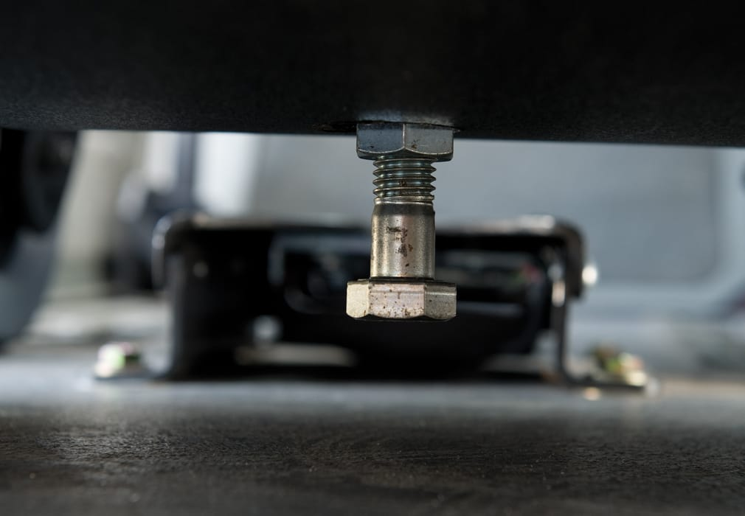
Passenger Vehicles: Docking-Type WTORS
Most common design is hanging bolt that can be “docked” into a floor mounted bracket.
Extra stabilizing bracket
Secures one specifically modified wheelchair to one specifically modified vehicle.
Requires hardware to be added to WC, often against WC manufacturers instructions.
Requires good alignment.
Reduces ground clearance.
Can be independently used.

Slide 16
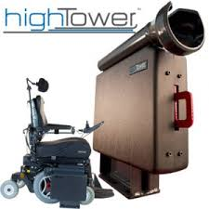
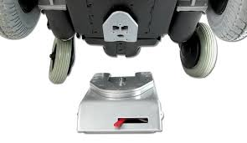
Passenger Vehicles: Docking-Type WTORS
Less popular but crashworthy docking systems
Some are not supplied with a seat belt, so not complete WTORS
For use in privately-owned, modified vehicles.

Slide 17
WTORS for Heavy Vehicles
Severe crash events unlikely, so systems can be less robust.
Ambulatory passengers are often allowed to stand during travel.
Conventional seating has no seat belts
On time service issues
Tipping over and sliding out of the WC are common issues during travel

Slide 18
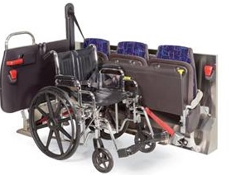
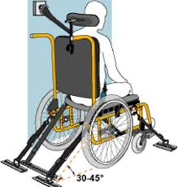
WTORS for Heavy Vehicles
3-pt tiedowns
4-pt tiedowns
Often requires assistance
Lap Belt routing issues
Can be rear-facing

Slide 19
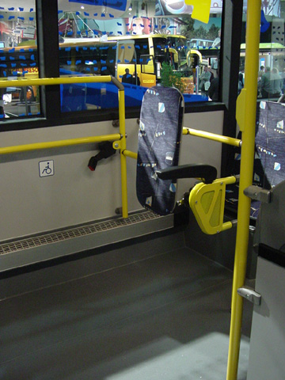
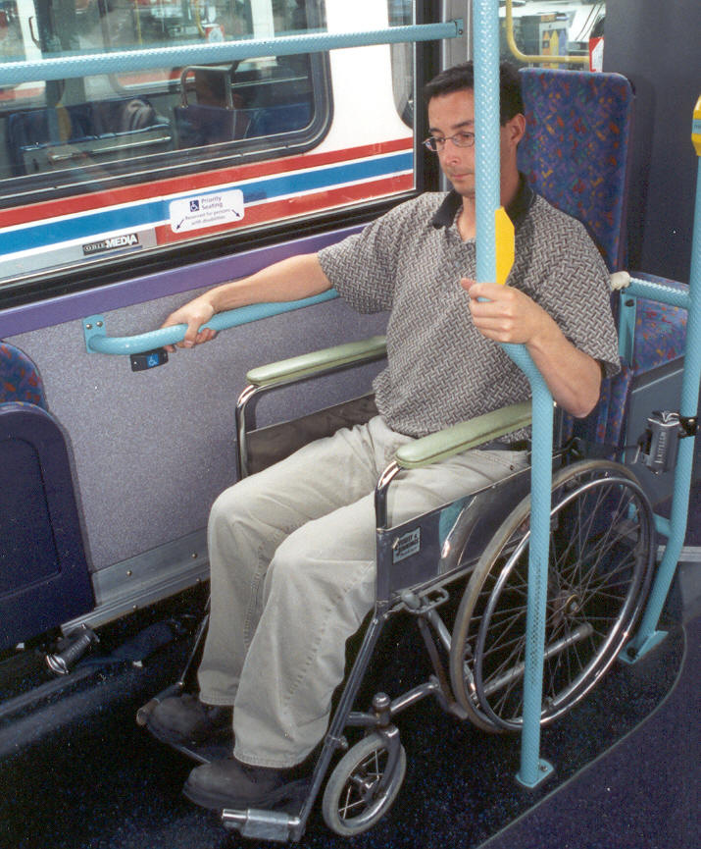
WTORS for Heavy Vehicles
Rear facing stations:
Padded surface with hand holds
Some have lap belt
Can be used independently
Motion sickness and viewing
stops can be issues
Less dwell time
Less driver interaction

Slide 20
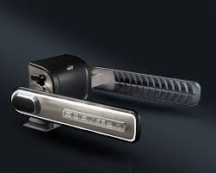
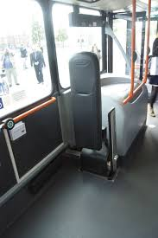
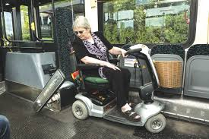
WTORS for Heavy Vehicles
Rear facing system with lateral clamping surfaces “Quantum”
Similar advantages to rear-facing stations (quick, independent)
More stabilization of WC

Slide 21
WTORS Pros and Cons
WTORS Type | Independent Use? | Protects in all vehicles – both low and high g environments? | Allows all combinations of vehicle and wheelchair?
4-point straps paired with seat belt | No | Yes | Yes
Docking paired with seat belt | Yes | Yes | No
Rear facing stations | Yes | No | Yes
For AVs – We need an all “yes” solution

Slide 22
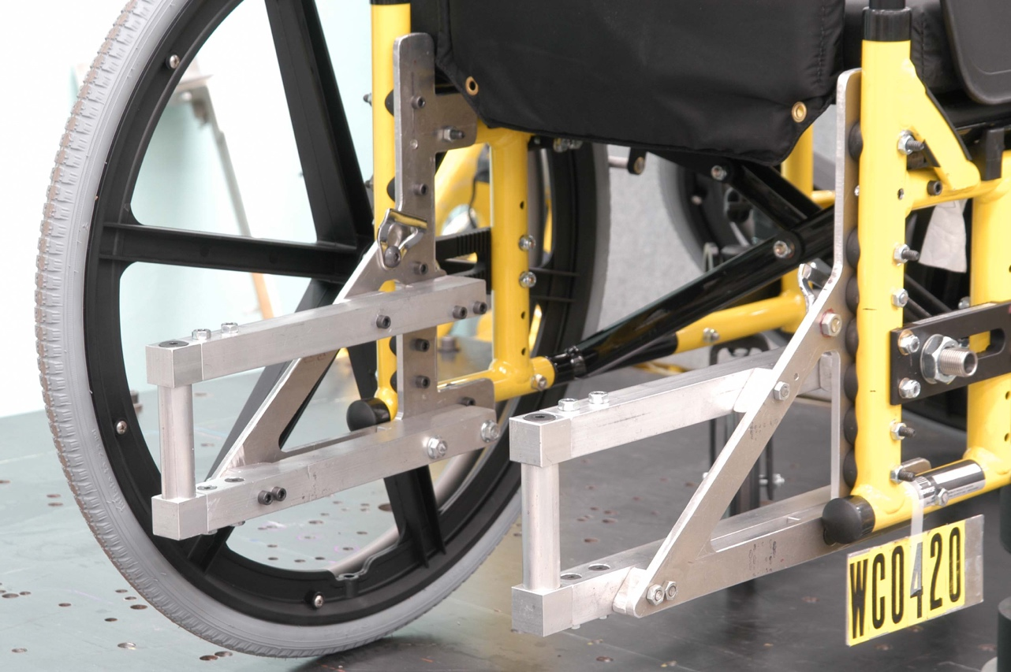
Passenger Vehicles:
Universal Docking Geometry (UDIG)
Common geometry for connection wheelchairs to vehicles. Based on the idea of truck trailer hitch
If implemented, allows a wheelchair to use docking in
all types of vehicles.
Geometry has been defined
and field tested.
Requires both WC and WTORS manufacturers to work together
Already implemented in standards
No commercial use.

Slide 23
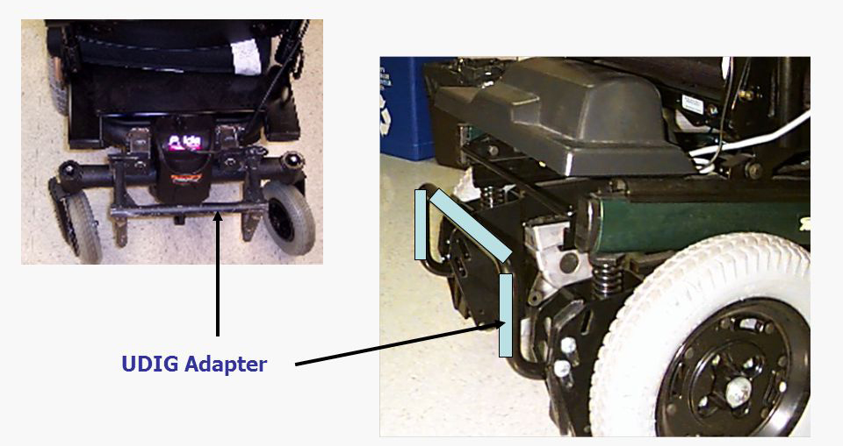
Passenger Vehicles: Universal Docking(UDIG)

Slide 24
Occupant Protection Issues
Seat belt use, misuse and fit continue to be problematic
Wheelchair-seated occupant are higher and more upright than other passengers, so airbags deployment zones and padding placement is not tuned for these positions.
Head and back support issues. Very difficult to get good fit and proximity while seated in wheelchairs.

Slide 25
Field Data on Independent Use of WTORS
Main observations:
Seatbelt use and fit vary widely from “none” to “poor” to “good,” depending on wheelchair design (e.g., armrest type), level of disability (active versus passive use), and other factors.

Slide 26
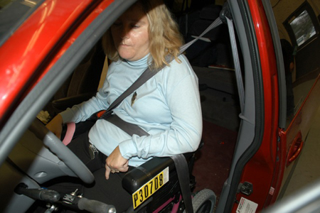
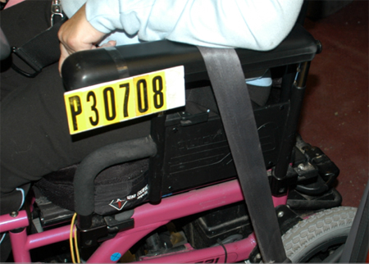
Field Data on Independent Use of WTORS
Main observations:
  The type of wheelchair armrest is critical role to achieving proper belt restraint for wheelchair-seated drivers.
  Closed armrests ➔ poor belt fit

Slide 27
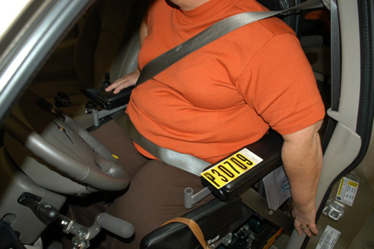
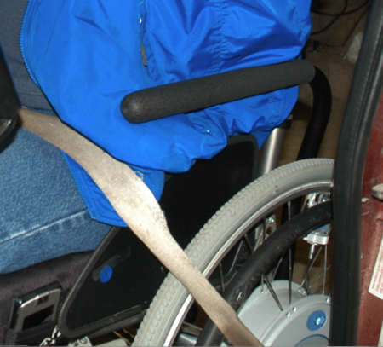
Field Data on Independent Use of WTORS
Main observations:
  The type of wheelchair armrest is critical role to achieving proper belt restraint for wheelchair-seated drivers.
  Open armrests ➔ good belt fit

Slide 28
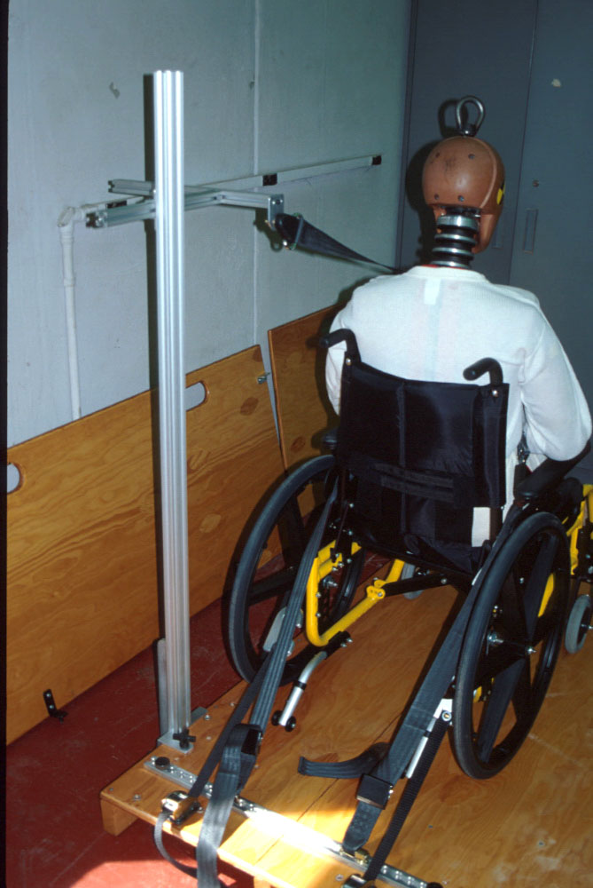
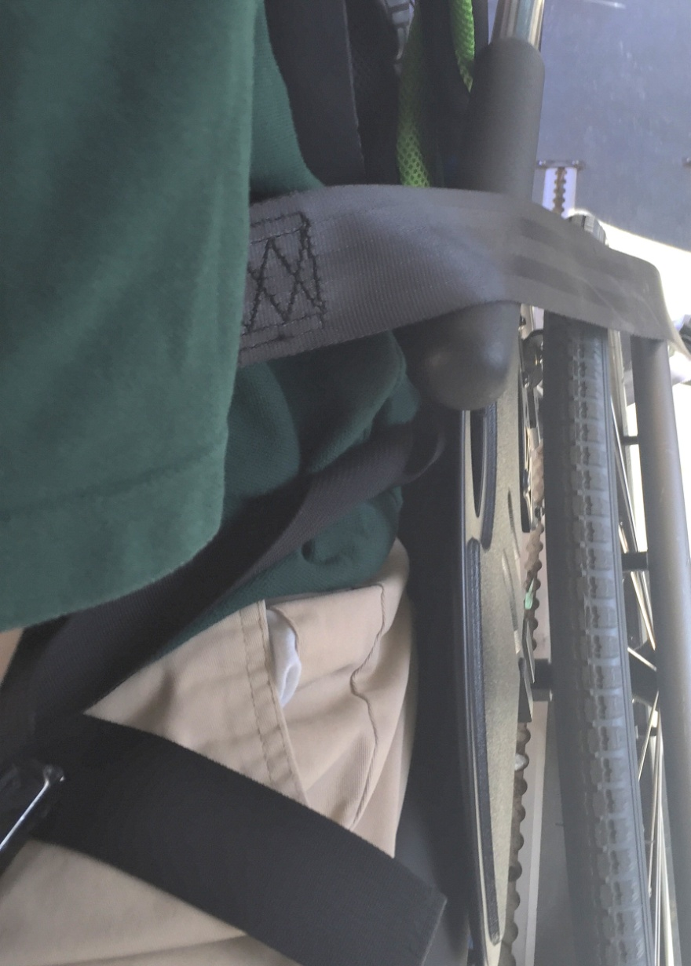
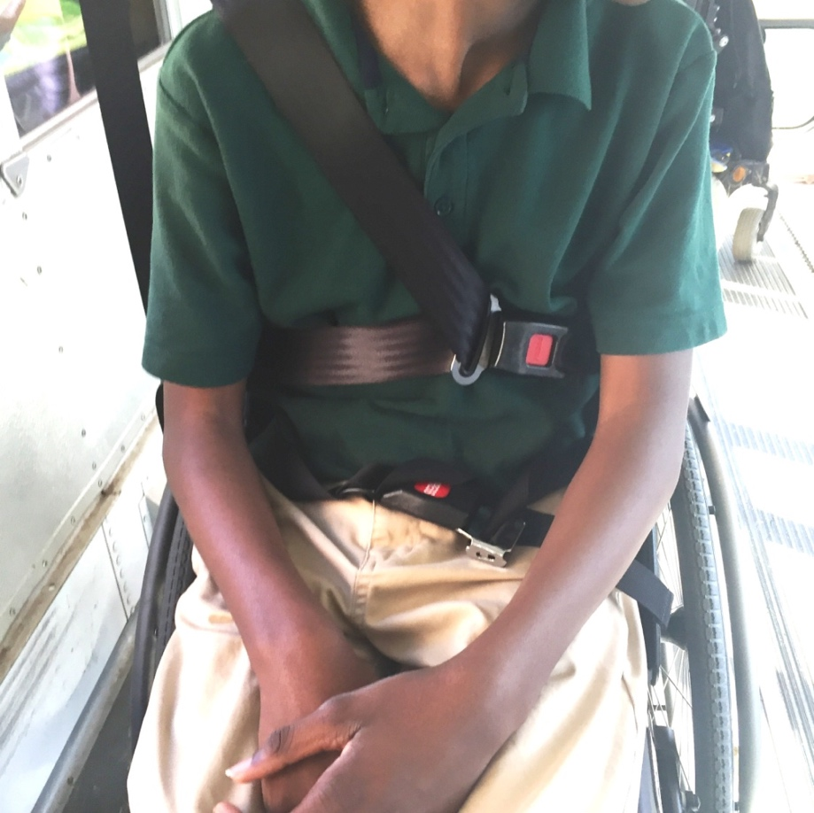
Three Types of Crashworthy Seat Belts
#1 Lap and Shoulder belt that only anchors to vehicle
Hardest to get good fit
Most common in field
New WC19 rates WC for compatibility with vehicle

Slide 29
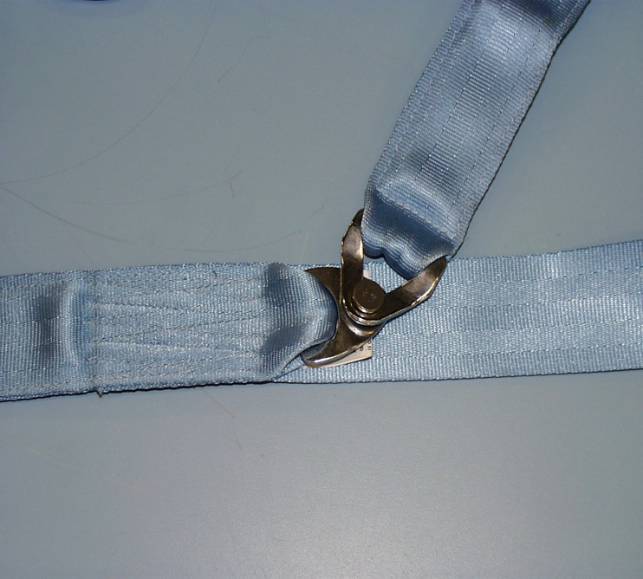
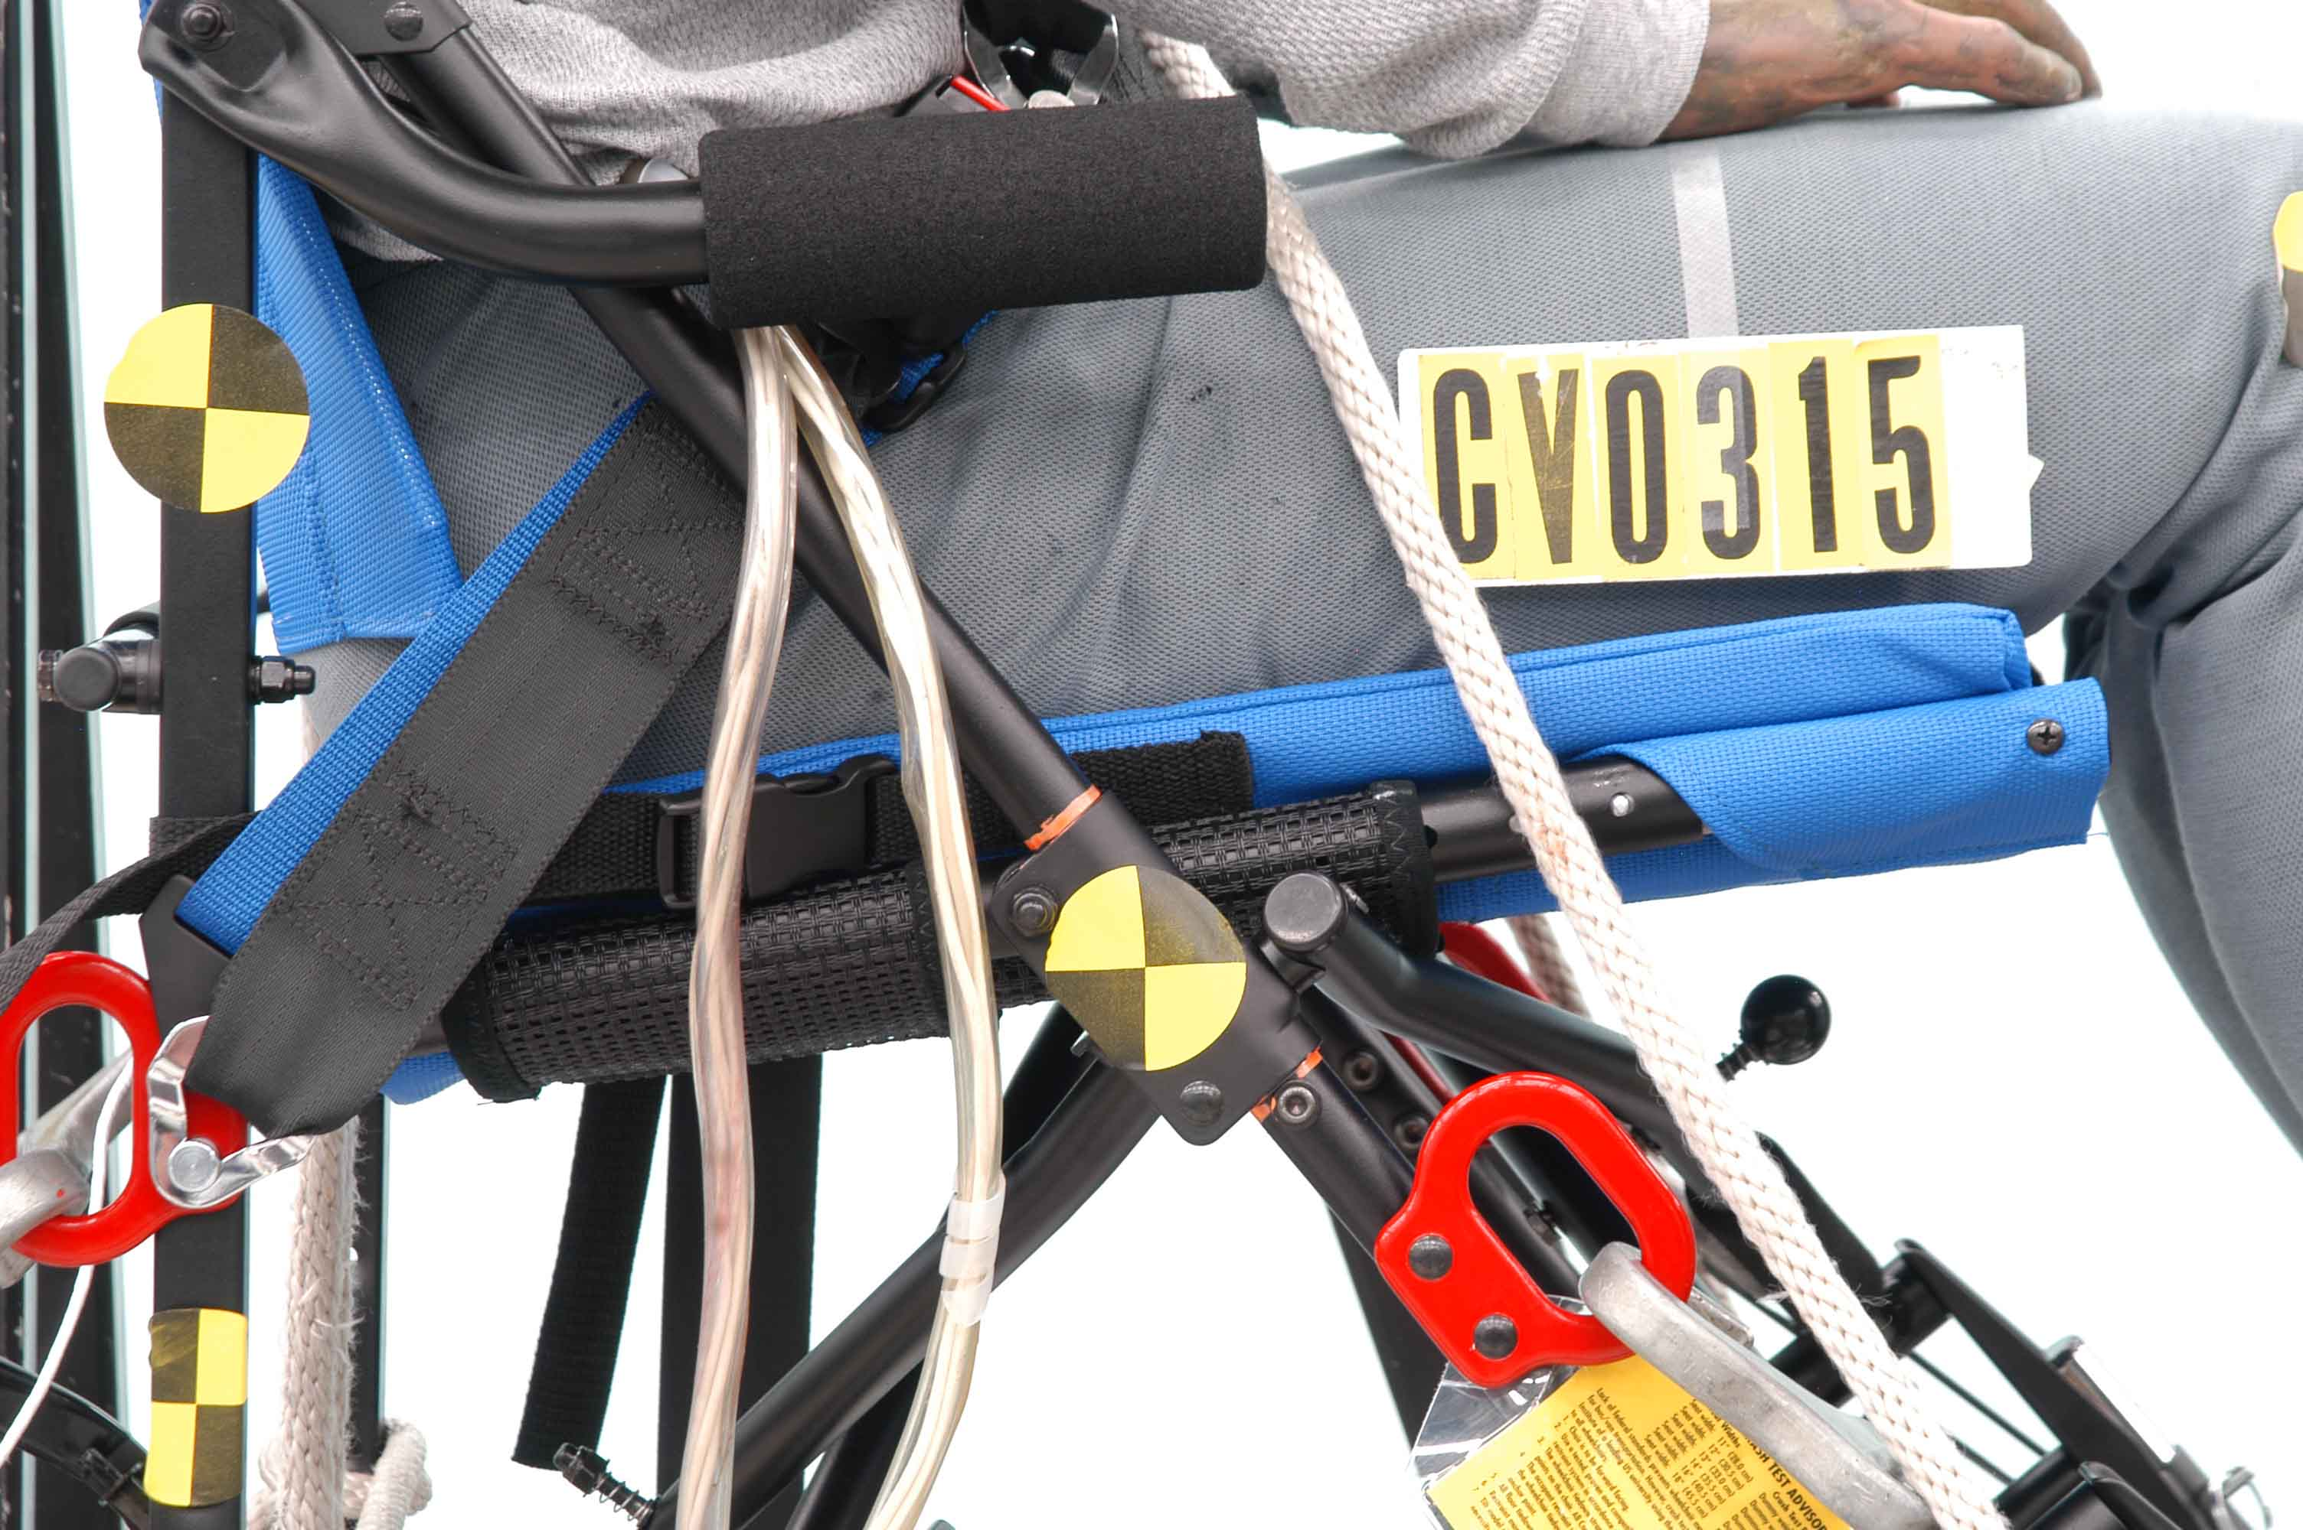
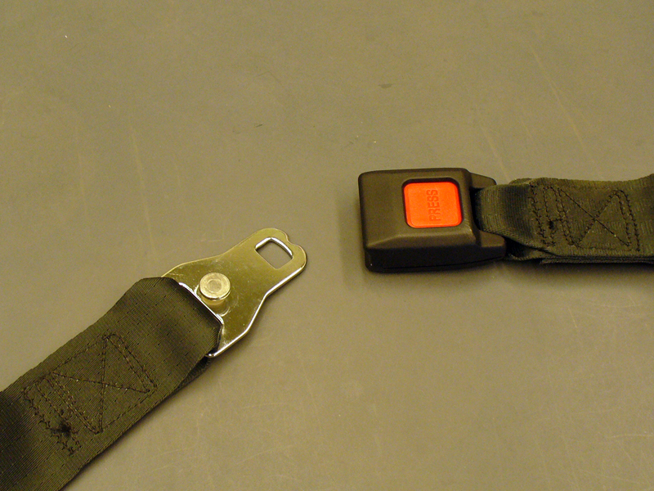
Three Types of Crashworthy Seat Belts
#2 Lap and shoulder belt with ends of lap belt anchored to WC
WC19 wheelchairs must provide the user with the option of a wheelchair-anchored lap-belt restraint with connector for attaching vehicle-anchored shoulder belt.
Will be marked with WC19 symbol and or WC19 text

Slide 30
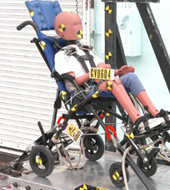
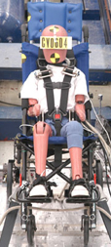
Three Types of Crashworthy Seat Belts
#3 A crashworthy 5 point system that anchors to the wheelchair
Two shoulder straps, two lap straps, and crotch strap
Just like child safety seats
New WC19 requirements for wheelchairs to provide a five-point system and head support for children under 50 lb

Slide 31
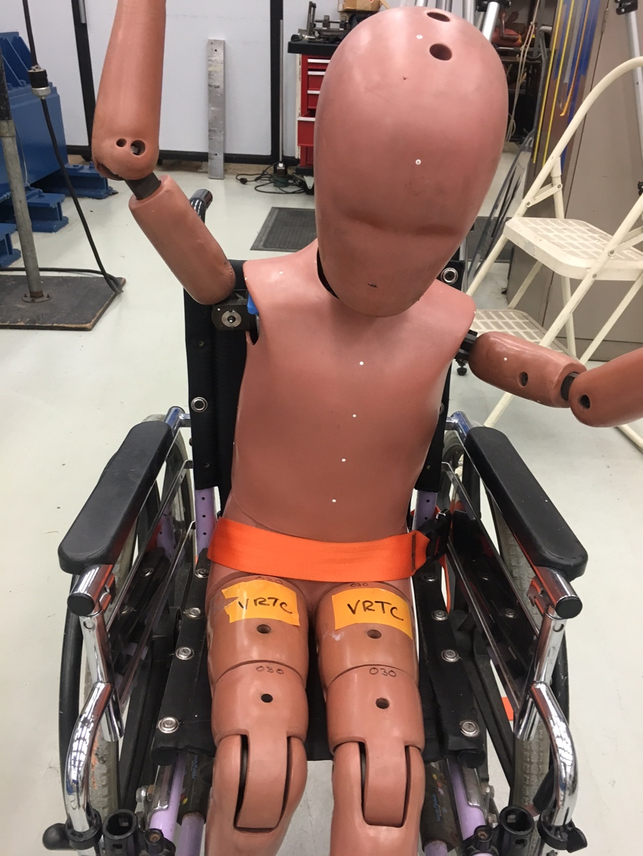
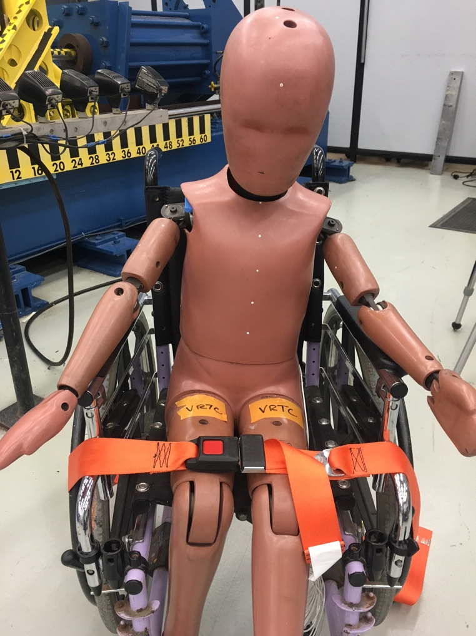
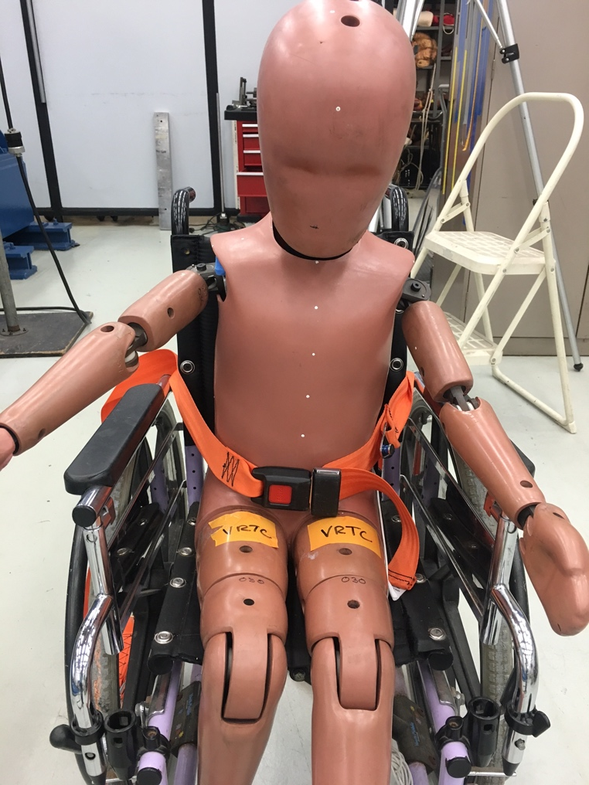
Advantages of Wheelchair-Anchored Belts
Better fit to rider!
NO
NO
Yes

Slide 32
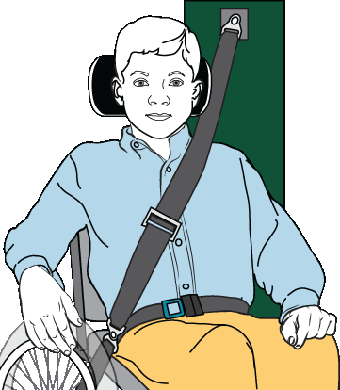
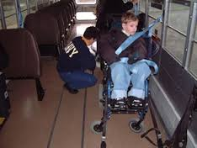
Advantages of Wheelchair-Anchored Belts
Less intrusion of personal space
Reduces ingress/egress time
Eliminates challenging routing
through WC hardware

Slide 33
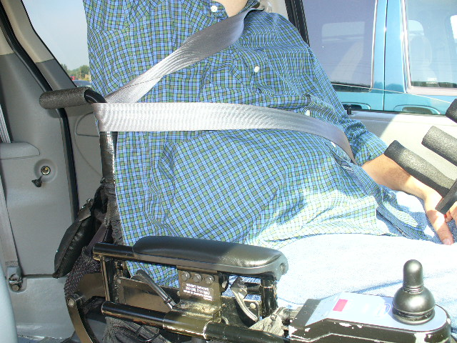
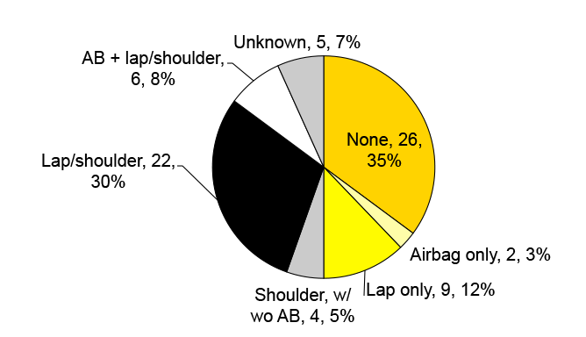
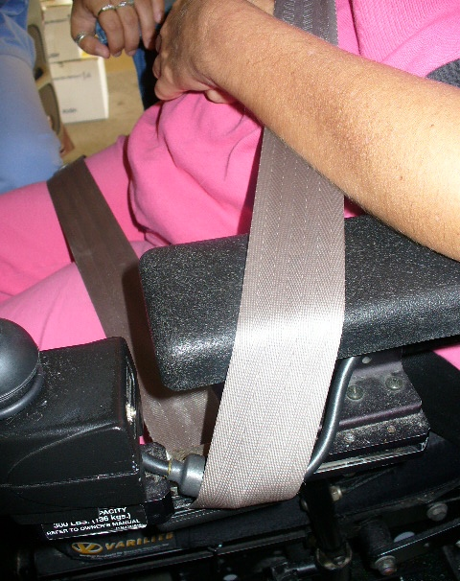
Advantages of Wheelchair-Anchored Belts
Addresses alarming data about misuse and nonuse of seatbelt in the field for people in WC

Slide 34

Advantages of Wheelchair-Anchored Belts
Less confusion about which belt is postural and which belt is for crash protection

Slide 35
WTS Challenges in AVs
Ramp angles
Door openings
Heavier and larger wheelchairs.
Interior space and room for turns.
Changing distribution of crash directions.
Independent securement of wheelchairs.
Independent donning of seat belts.
Headroom
Wheelchairs often place occupants higher and more upright than conventional seating, so occupant protection systems need to accommodate this difference in position.

Slide 36
Barriers to Progress in WTS
Most wheelchairs are not designed for use as a seat in a motor vehicle.
Features of wheelchairs, like arm supports, can make good seat belt fit difficult or impossible.
Efforts to move toward wheelchair-anchored crashworthy lap belts is slow.
WTS equipment is expensive and usually not covered by insurance.
General lack of awareness of best practices in WTS.
Need options for independent docking in high g vehicles.
Need to improve seatbelt use and fit.

Slide 37
Potential Solutions
Increase options/prescription of WC19 compliant wheelchairs.
Inform WC manufacturers about WC design features that conflict with safety.
Increased use of wheelchair-anchored crashworthy lap belts.
Work with WC manufacturers on securement to eliminate the need for docking adapters.
Can transit option be standard?
Get the word out about best practices in WTS.
Consider UDIG or next generation UDIG.
Improve seatbelt use and fit → Passive belt donning systems?

Slide 38



Potential Solutions
Passive Restraints?

Slide 39

Questions?
http://wc-transportation-safety.umtri.umich.edu/

